Slide 1
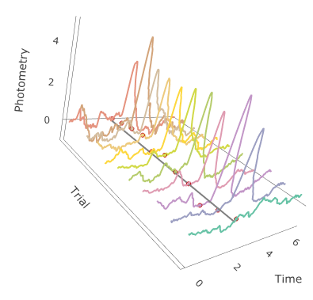

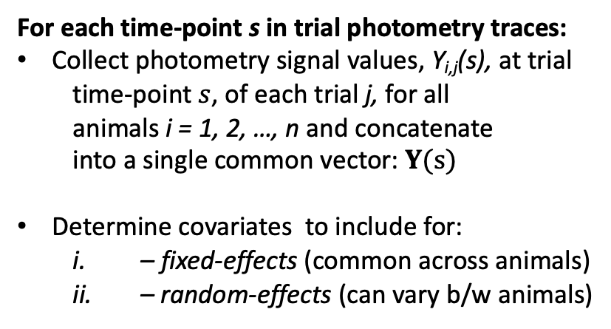

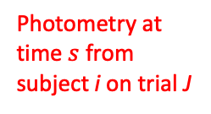
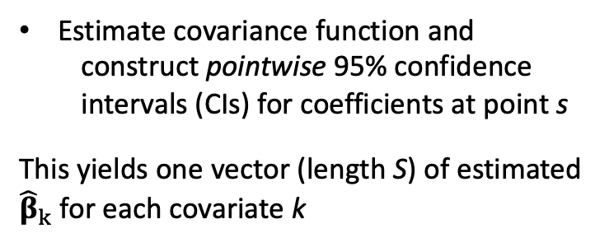
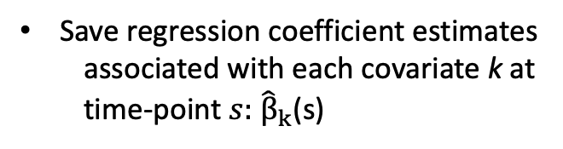

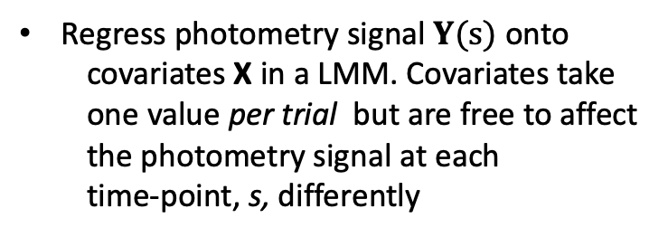

A
For each time-point s in trial photometry traces:
Collect photometry signal values, Y_{i,j}(s), at trial
time-point $s$, of each trial j, for all
animals i = 1, 2, …, n and concatenate
into a single common vector: $Y(s)$
Determine covariates to include for:
– fixed-effects (common across animals)
– random-effects (can vary b/w animals)
$$s$$
Photometry at
time $s$ from
subject i on trial J
$$s$$
Regress photometry signal $Y(s)$ onto
covariates X in a LMM. Covariates take
one value per trial but are free to affect
the photometry signal at each
time-point, s, differently
Save regression coefficient estimates
associated with each covariate k at
time-point $s:$ ${\hat{β}}_{k}$(s)
Estimate covariance function and
construct pointwise 95% confidence
intervals (CIs) for coefficients at point s
This yields one vector (length S) of estimated
${\hat{β}}_{k}$ for each covariate k
s
$$s$$
$$s$$

Slide 2


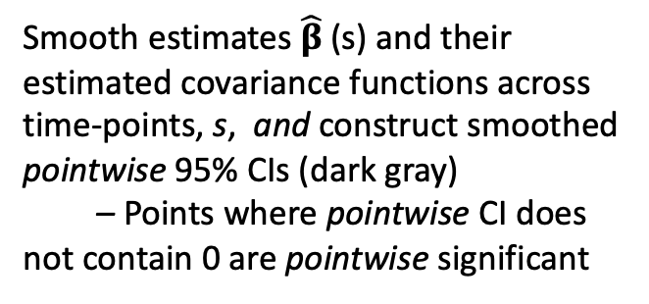

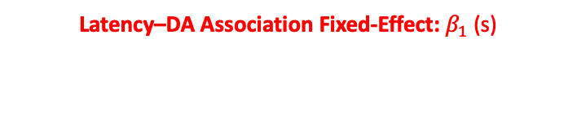

Smooth estimates ${\hat{β}}_{ }$(s) and their
estimated covariance functions across time-points, s, and construct smoothed pointwise 95% CIs (dark gray)
– Points where pointwise CI does not contain 0 are pointwise significant
Calculate joint 95% CIs for the entire curve.
– Intervals for which joint 95% CI
(light gray) does not contain 0 anywhere
are jointly statistically significant.
B
$$Y(1.7)$$
Example time-point: 1.7 sec
Model includes fixed- and random-effects
for Latency ( ):
Example: DA–Latency Association
Trials
$ΔF$/ $F$
0$1.7 4$
Trial time-point
Latency–DA Association Fixed-Effect: ${β_{1}}_{ }$(s)
Latency–DA Random-Effect for Animal 2

